Slide 1

Proofs, Induction, and Number Theory
Mathematical Structures for Computer Science
Chapter 2
Copyright © 2014 W.H. Freeman & Co. MSCS Slides Section 2.1

Slide 2
Informal Proofs
Usually we prove results about a specific subject.
  Such results need not be universally true
  We can introduce hypotheses that are true only in this domain
Proofs can be much more conversational, as long as they can be backed up by formal justifications.
Inductive reasoning
  Drawing a conclusion from a hypothesis based on experience. Hence the more cases you find where Q follows from P, the more confident you are about the conjecture P → Q.
Deductive reasoning
  find a counterexample that disproves the conjecture
  or
  prove the conjecture true
Section 2.1
Proof Techniques

Slide 3
Deductive Reasoning: Counter Example
Given a conjecture P → Q.
To disprove, look for a case where P is true but Q is false.
Example: Prove that “For every positive integer n, n! ≤ n².”
  Start testing some cases say, n = 1, 2, 3 etc.
  It might seem like it is true for some cases but how far do you test, say n = 4.
  We get n! = 24 and n² = 16 which is a counter example for this theorem.
  Please note even finding a single case that does not satisfy the implication is enough to disprove the conjecture.
Section 2.1
Proof Techniques

Slide 4
Counterexample
More examples of counterexample:
  All animals living in the ocean are fish.
    A whale
  Every integer less than 10 is bigger than 5.
    The integer 4
Section 2.1
Proof Techniques

Slide 5
Proof Techniques
If you cannot disprove a conjecture by finding a counterexample, then try to prove that it is true.
Possible methods of proof:
  Proof by exhaustion
  Direct proof
  Proof by contraposition
  Proof by contradiction
  Serendipity
Section 2.1
Proof Techniques

Slide 6
Exhaustive Proof
If dealing with a finite domain in which the conjecture is to be shown true, then using the exhaustive proof technique, one can go over all the possible cases for each member of the finite domain.
Final result of this exercise: you prove or disprove the theorem but you could be definitely exhausted (depending on the magnitude of the number of members in the domain!).
Example: For any positive integer less than or equal to 5, the square of the integer is less than or equal to the sum of 10 plus 5 times the integer.
n | n² | 10+5n | n² < 10+5n
0 | 0 | 10 | yes
1 | 1 | 15 | yes
2 | 4 | 20 | yes
3 | 9 | 25 | yes
4 | 16 | 30 | yes
5 | 25 | 35 | yes
Section 2.1
Proof Techniques

Slide 7
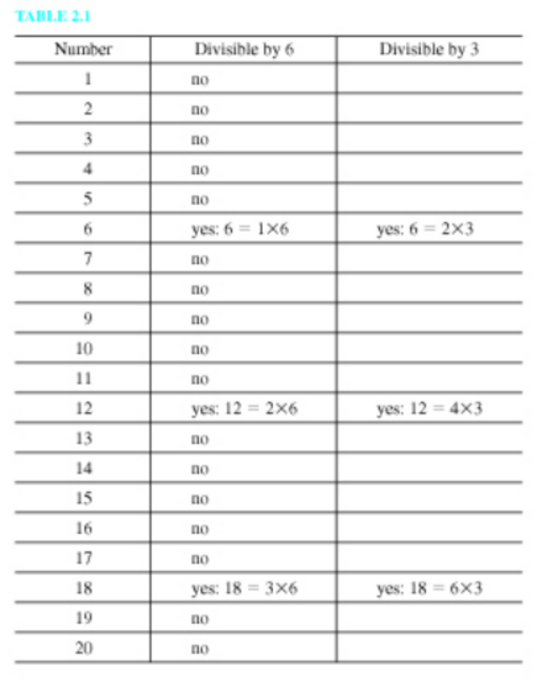
Example: Exhaustive Proof
Example 1: If an integer between 1 and 20 is divisible by 6, then it is also divisible by 3.
Section 2.1
Proof Techniques

Slide 8
Direct Proof
Direct Proof of P → Q:
Used when exhaustive proof does not apply.
Assume the hypothesis P and prove the conclusion Q.
Consider the conjecture
x is an even integer Λ y is an even integer → the product xy is an even integer.
A complete formal proof sequence might look like the following:
  x is an even integer Λ y is an even integer hyp
  (∀x)[x is even integer →(∃k)(k is an integer Λ x = 2k)] number fact (definition of even integer)
  x is even integer →(∃k)(k is an integer Λ x = 2k) 2,ui (Table 1.17, Pg 59, Universal Instantiation)
  y is even integer →(∃k)(k is an integer Λ y = 2k) 2,ui
  x is an even integer 1,sim (Table 1.12, Pg 29, Simplification)
  (∃k)(k is an integer Λ x = 2k) 3, 5, mp, (Table 1.12, Pg 29 Modus Ponens)
  m is an integer Λ x = 2m 6, ei (Table 1.17, Table 1.17, Existential Instantiation)
  y is an even integer 1,sim
Section 2.1
Proof Techniques

Slide 9
Direct Proof Example (contd.)
(∃k)(k is an integer Λ y = 2k) 4,8,mp
n is an integer and y = 2n 9, ei
x = 2m 7,sim
y = 2n 10, sim
xy = (2m)(2n) 11, 12, substitution of equals
xy = 2(2mn) 13, multiplication fact
m is an integer 7,sim
n is an integer 10, sim
2mn is an integer 15, 16, number fact
xy = 2(2mn) Λ 2mn is an integer 14, 17, con
(∃k)(k is an integer Λ xy = 2k) 18,eg (Table 1.17, Pg 59, Existential Generalization)
(∀x)((∃k)(k is an integer Λ x = 2k) → x is even integer) number fact (definition of even integer)
(∃k)(k an integer Λ xy = 2k) → xy is even integer 20, ui
xy is an even integer 19, 21, mp
Section 2.1
Proof Techniques

Slide 10
Informal Direct Proof
The previous formal proof would hardly ever be needed.
Instead,
    Let x = 2m and y = 2n, where m and n are integers.
    Then xy = (2m)(2n) = 2(2mn), where 2mn is an integer.
    Thus xy has the form 2k, where k is an integer,
    and xy is therefore even.
Section 2.1
Proof Techniques

Slide 11
Proof by Contraposition
Use the variants of P → Q to prove the conjecture. From the inference rules of propositional logic, we know a rule called contraposition (termed “cont” in short).
It states that (Q′ → P′) → (P → Q) (a tautology).
Q′ → P′ is the contrapositive of P → Q.
Hence, proving the contrapositive implies proving the conjecture.
Example: Prove that if the square of an integer is odd, then the integer must be odd
  Hence, prove n² odd → n odd
  To do a proof by contraposition prove n even → n² even
  If n is even, then it can be written as 2m where m is an integer
  Then, n² = 4m² which is always even no matter what m² is because of the factor 4.
  Therefore, the contraposition is also true
    n² odd → n odd
Section 2.1
Proof Techniques

Slide 12
Indirect Proof: Proof by Contradiction
Let 0 be any contradiction (always false).
Then (P Λ Q′ → 0) → (P → Q) is a tautology.
Hence, proving P Λ Q′ → 0 implies proving the conjecture.
In a proof of P → Q by contradiction, one assumes that the hypothesis and the negation of the conclusion are true and then try to deduce some contradiction from these assumptions.
Example 1: Prove that “If a number added to itself gives itself, then the number is 0.”
  The hypothesis (P) is x + x = x and the conclusion (Q) is x = 0. Hence, the hypotheses for the proof by contradiction are:
  x + x = x and x ≠0 (the negation of the conclusion)
  Then 2x = x and x ≠0, hence dividing both sides by x, the result is 2 = 1, which is a contradiction. Hence, (x + x = x) → (x = 0).
Section 2.1
Proof Techniques

Slide 13
Proof by Contradiction
Example 2: The sum of even integers is even.
  Proof: Let x = 2m, y = 2n for integers m and n and assume that
  x + y is odd.
  Then x + y = 2m + 2n = 2k + 1 for some integer k.
  Hence, 2*(m + n - k) = 1, where m + n - k is some integer.
  This is a contradiction since 1 is not even.
Example 3: If x² + 1 = 6 then x ≠ 4
  Proof: Let x² + 1 = 6 and assume that x = 4.
  Then x² + 1 = (4)² + 1 = 16 + 1 = 6
  This is a contradiction since 16 ≠ 5
Section 2.1
Proof Techniques

Slide 14
Serendipity
Serendipity: Fortuitous happening or something by chance or good luck.
Not a formal proof technique.
Interesting proofs provided by this method although other methods can be used as well.
Example: 342 players in a tennis tournament. One winner in the end. Each match is between two players with exactly one winner and the loser gets eliminated. Prove the total number of matches played in the tournament is 341.
  Solution: Only one champion at the end of the tournament, hence 341 losers at the end, hence 341 matches should have been played to have 341 losers.
Section 2.1
Proof Techniques

Slide 15
Summarizing Proof techniques
Proof Technique | Approach to prove P → Q | Remarks
Exhaustive Proof | Demonstrate P → Q for all cases | May be used only for finite number of cases
Direct Proof | Assume P, deduce Q | The standard approach- usually the thing to try
Proof by Contraposition | Assume Q′, derive P′ | Use this if Q′ as a hypothesis seems to give more ammunition then P would
Proof by Contradiction | Assume P Λ Q′ , deduce a contradiction | Use this when Q says something is not true
Serendipity | Not really a proof technique | Fun to know
Section 2.1
Proof Techniques

Slide 16
Class Exercise
Product of any 2 consecutive integers is even.
The sum of any 3 consecutive integers is even.
Product of 3 consecutive integers is even.
The square of an odd integer equals 8k+1 for some integer k.
The sum of two rational numbers is rational.
For some positive integer x, x + 1/x ≥ 2.
Section 2.1
Proof Techniques
Notes:
(2m + 1)*(2m + 2) or 2m*(2m+1)
Counter example. 2+3+4 = 9
2n*(2n+1)*(2n+2) or (2n-1)*(2n)*(2n+1)
(2n+1)² = 4n(n+1) + 1 and n(n+1) is always even i.e. 2k hence 8k+1
p/q+r/s = (ps+qr)/qs
Prove by contradiction
Say x+1/x < 2 then solving this leads to (x-1)² < 0 which can never be true

Slide 17
Class Exercise
  Prove: Product of any 2 consecutive integers is even.
  X is an integer Hypothesis
  X + 1 is the next Integer Hypothesis, 1
  Case 1: (X is even; the other case is X is odd and is similarly proved)
  X is even integer →(∃m)(m is an integer Λ X = 2m) 2,ui (Table 1.17, Pg 59)
  m is an integer Λ X = 2m 3, mp
  X = 2m Simplification
  X + 1 = 2m + 1 2, 5
  2m + 1 is an integer and is odd 3, 6, 1 added to an integer yields an integer
  X(X+1) = 2m (2m+1) 1, 2, 5, 6, Multiplication
  2m(2m+1) = 4m² + 2m 8, By basic math, multiplication
  4m² + 2m = 2(2m² + m) 9, factoring
  m is an integer 4, simplification
  (2m² + m) is an integer 11, because the numbers 2 and m are integers
  (∃Y) (Y is an integer Λ 2m² + m = Y) 12, ei (table 1.17, pg. 59, existential Instantiation)
  2m² + m = Y 13, sim (Table 1.12, Pg 29, Simplification)
  X(X+1) = 2Y 8, 10, 14
  X(X+1) is an even number Anything multiplied by 2 is an even number
Section 2.1
Proof Techniques
Notes:
(2m + 1)*(2m + 2) or 2m*(2m+1)
Counter example. 2+3+4 = 9
2n*(2n+1)*(2n+2) or (2n-1)*(2n)*(2n+1)
(2n+1)² = 4n(n+1) + 1 and n(n+1) is always even i.e. 2k hence 8k+1
p/q+r/s = (ps+qr)/qs
Prove by contradiction
Say x+1/x < 2 then solving this leads to (x-1)² < 0 which can never be true

Slide 18
Class Exercise
  Prove or disprove: The sum of any 3 consecutive integers is even. (Problem 2.1 ex 54)
  Doing the proof in a little less formal way we have the following:
  Since the problem says “the sum for any 3 consecutive integers is even” let’s pick three so let’s try to disprove it by a counterexample where the sum is odd.
  Pick 3 numbers and see if they are odd, if so then we have disproven the original statement.
  Let x = 2
  which then gives us: x + 1 = 3 and x + 2 = 4
  Are 2, 3, & 4 consecutive? Of course.
  The sum then is:
  = x + (x + 1) + (x + 2)
  = 2 + 3 + 4
  which is equal to 9!
  9 is certainly not even so we have disproven the original statement by counterexample.
Section 2.1
Proof Techniques
Notes:
(2m + 1)*(2m + 2) or 2m*(2m+1)
Counter example. 2+3+4 = 9
2n*(2n+1)*(2n+2) or (2n-1)*(2n)*(2n+1)
(2n+1)² = 4n(n+1) + 1 and n(n+1) is always even i.e. 2k hence 8k+1
p/q+r/s = (ps+qr)/qs
Prove by contradiction
Say x+1/x < 2 then solving this leads to (x-1)² < 0 which can never be true

Slide 19
Class Exercise
Prove or disprove: For some positive integer x, x + 1/x ≥ 2.
  Doing the proof in a little less formal way we have the following:
  Caution, read the statement very carefully. It reads “For some positive integer x, x + 1/x >= 2”. The key word here is “some” meaning there exists at least “one, some or a few”.
  Therefore if we can find at least 1 positive integer where this is true then the statement is true.
  Let’s start with the first positive integer, the number 1.
  x = 1
  The statement x + 1/x >= 2 then becomes:
  1 + 1/1 = 2, which is true.
  Therefore there is at least 1 positive integer for which the inequality is true,
  Therefore the statement is true.
Section 2.1
Proof Techniques
Notes:
(2m + 1)*(2m + 2) or 2m*(2m+1)
Counter example. 2+3+4 = 9
2n*(2n+1)*(2n+2) or (2n-1)*(2n)*(2n+1)
(2n+1)² = 4n(n+1) + 1 and n(n+1) is always even i.e. 2k hence 8k+1
p/q+r/s = (ps+qr)/qs
Prove by contradiction
Say x+1/x < 2 then solving this leads to (x-1)² < 0 which can never be true

